Slide 1

Developing foundational quantitative data skills: the UK Data Service training programme
Dr Vanessa Higgins
Director of Training and User Support, UK Data Service
Social Statistics and Cathie Marsh Institute, University of Manchester

Slide 2
Overview
The UK Data Service training programme
Interesting and relevant projects:
Resources for Higher Education teaching
Pilot asynchronous training for 3 Doctoral Training Partnerships
Results of qualitative research with students
Development of a data skills framework for quantitative data skills

Slide 3
UK Data Service
Funded by Economic and Social Research Council
Largest repository of social science research data in UK
Provides access to data: survey microdata, UK census data, longitudinal data
Delivered by 5 partners: Universities of Essex, Manchester, Edinburgh, UCL & JISC.
2024-2030 – new grant
Training remit:
Mostly remote training via online events and asynchronous online learning resources
Audience - anyone - students, researchers, HE teaching staff, non-academics

Slide 4
UK Data Service: training topics
Build capacity in 3 core topics:
Research Data Management | Finding and Accessing Data from the UK Data Service | Using data (foundational skills)
Data management planning: sharing, archiving and preserving data Anonymisation and licence/access frameworks Documentation and metadata standards Ethical and legal considerations | Data discovery How to access data Safe Researcher Training for the most confidential data | Introductions to data we hold: Datasets e.g Census, LFS Data types e.g Surveys Substantive themes e.g Crime Evaluating data for research Preparing data/data handling Basic data analysis skills Basic software/tools Teaching with data User conferences Computational Social Science Reproducible research
At the heart:
Getting started with secondary data analysis
Foundational level
User support and training for the data that we hold (Survey, Census, Longitudinal, Cohort, International Aggregate)
What we don't do:
Advanced methods training
Advanced statistical analysis training
Advanced coding training

Slide 5
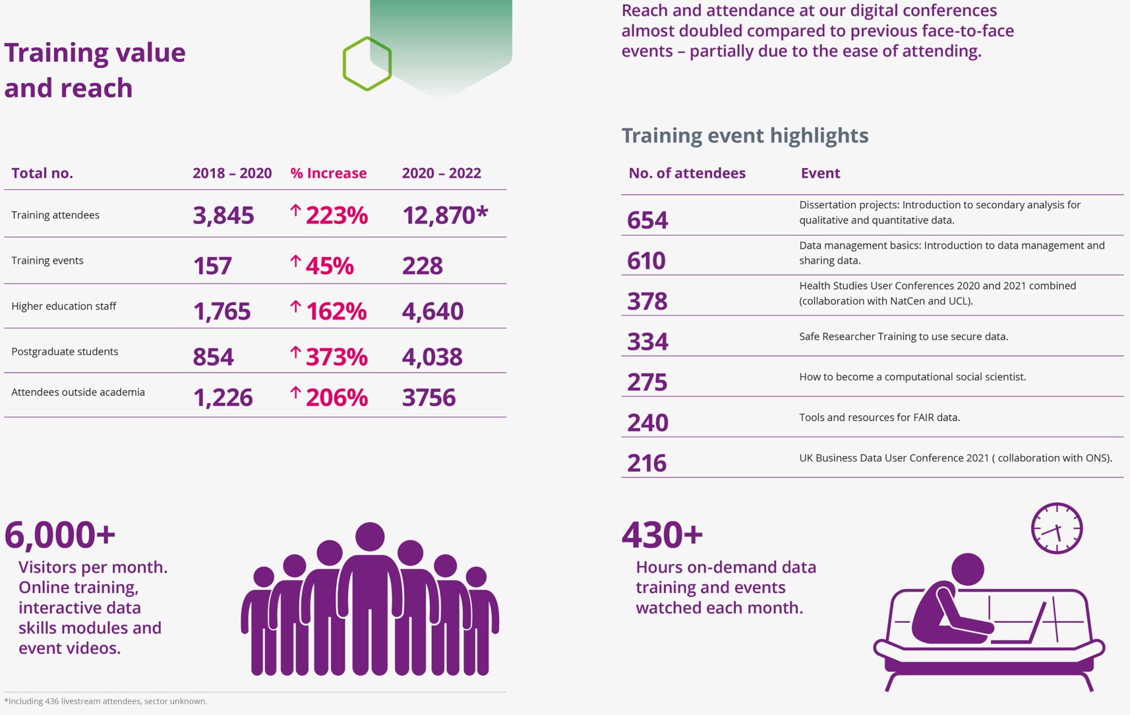

10k +7k YouTube

Slide 6
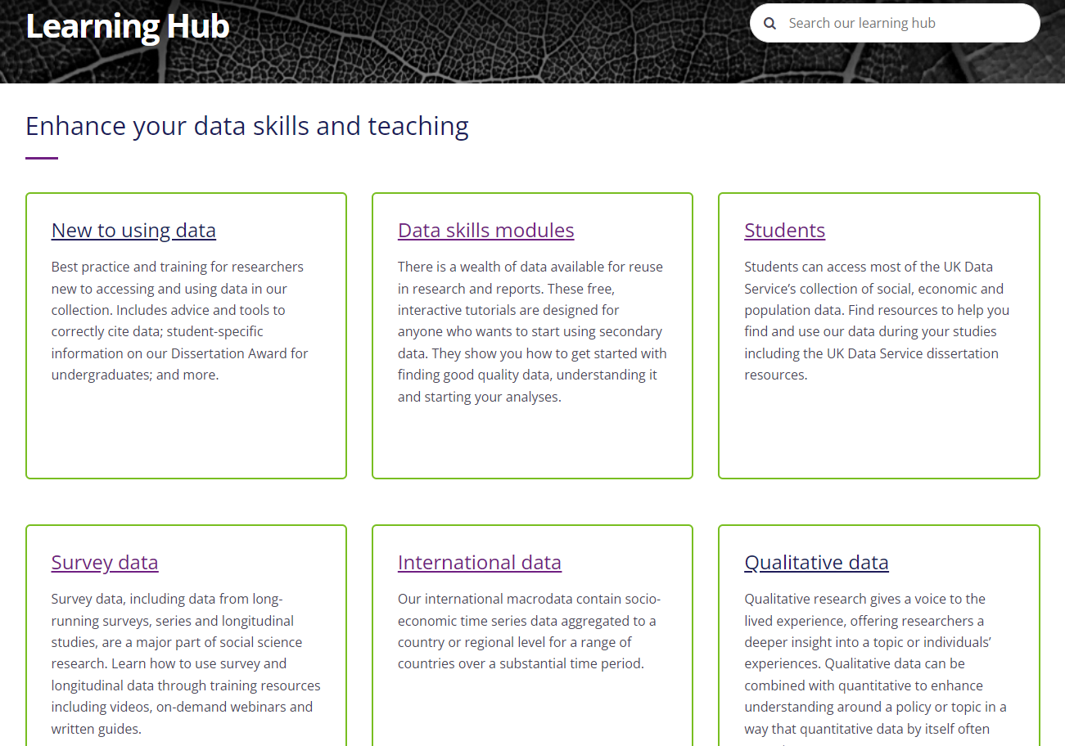
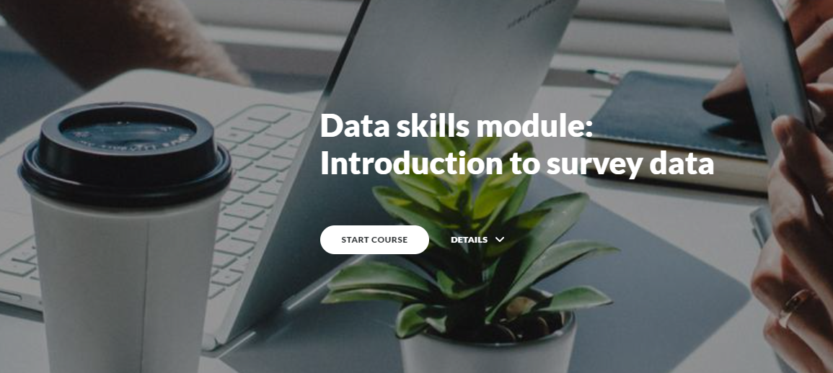
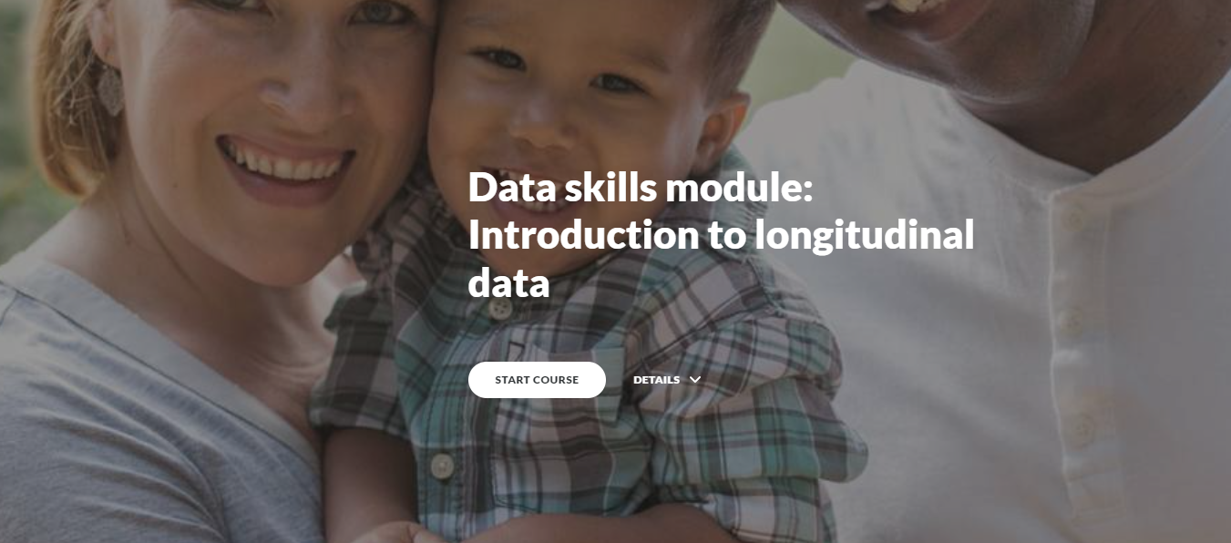
Asynchronous training: Learning Hub and YouTube
www. ukdataservice.ac.uk

Slide 7
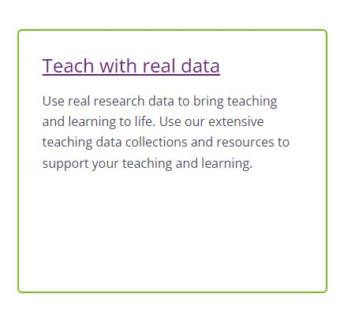
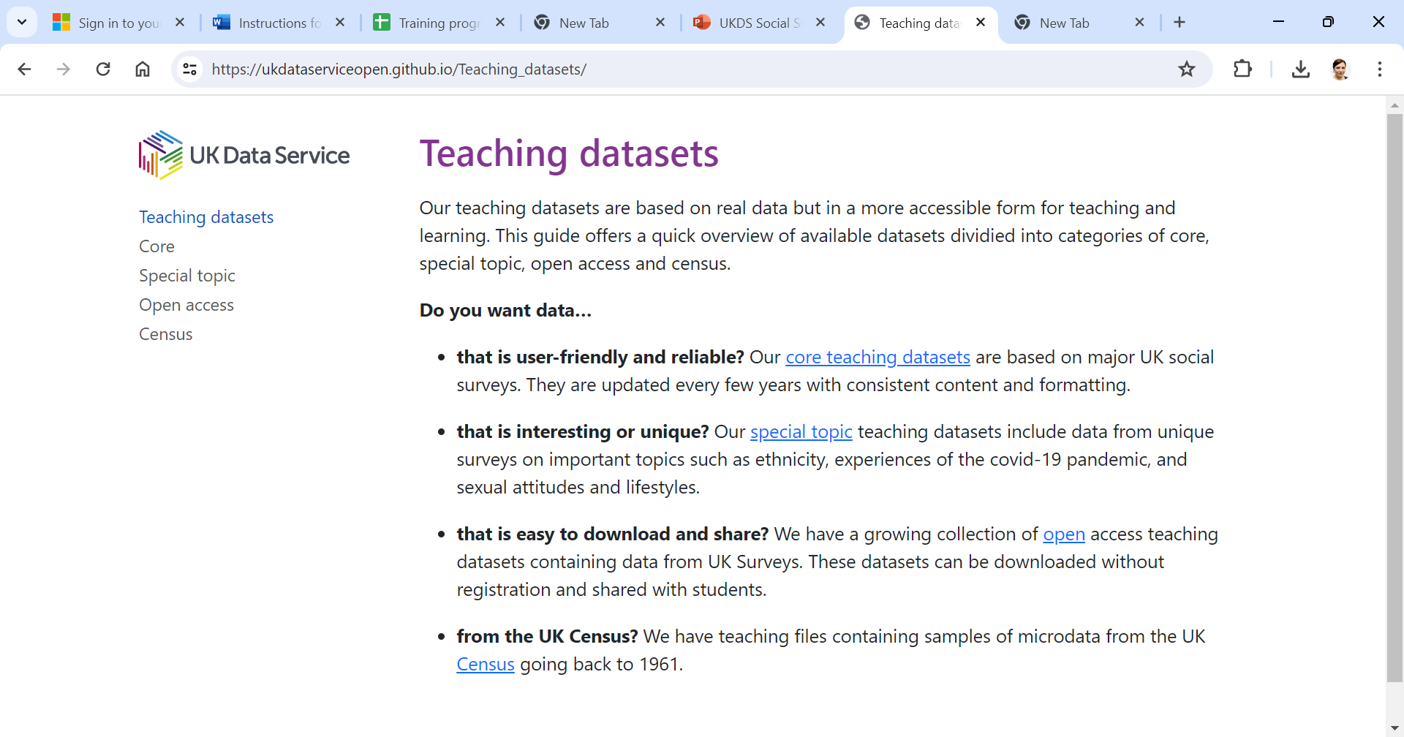
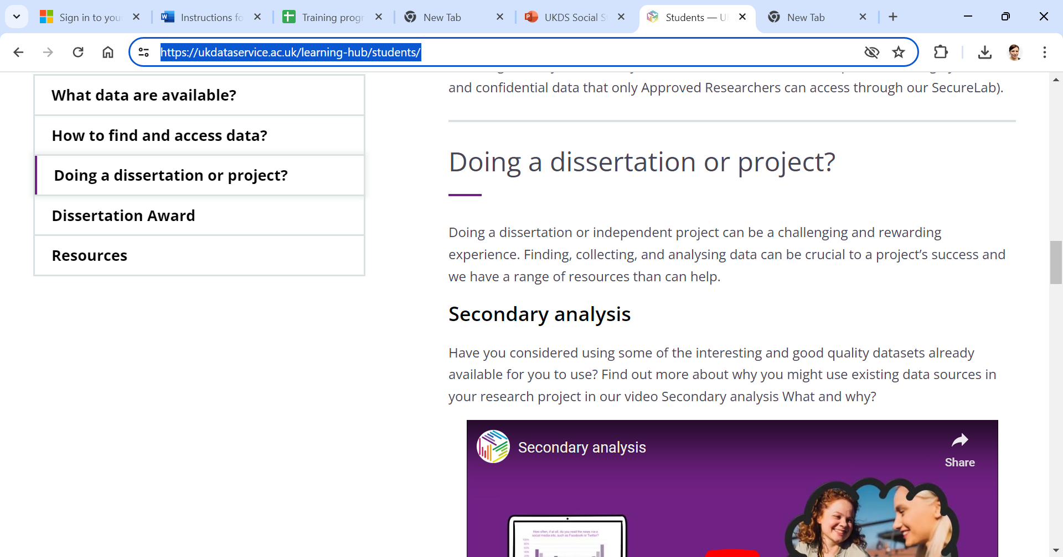
Resources for HE Teaching
Consult to understand context and needs: Teaching with data: Findings from the UK Data Service Higher Education
Teach with real data - area of our Learning Hub
Info about access to data for teaching including teaching datasets
Teaching resources
Student area of our learning hub
Resources for dissertations
Annual Dissertation Award (spread the word!). Deadline 20 June 2024
What's next? themed guides for students, simple guide to ethics for secondary data, international datasets, teaching reproducibility
Ideas and collaborations welcome!

Slide 8
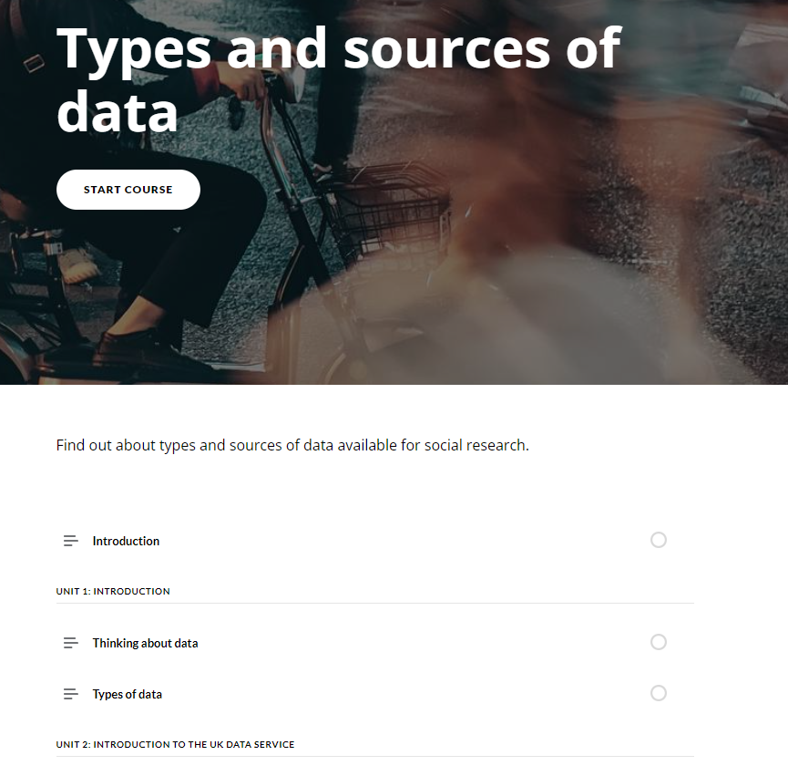
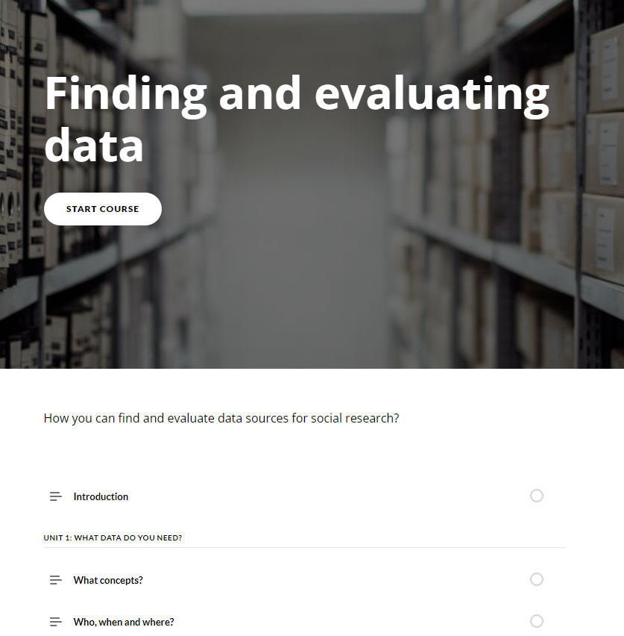
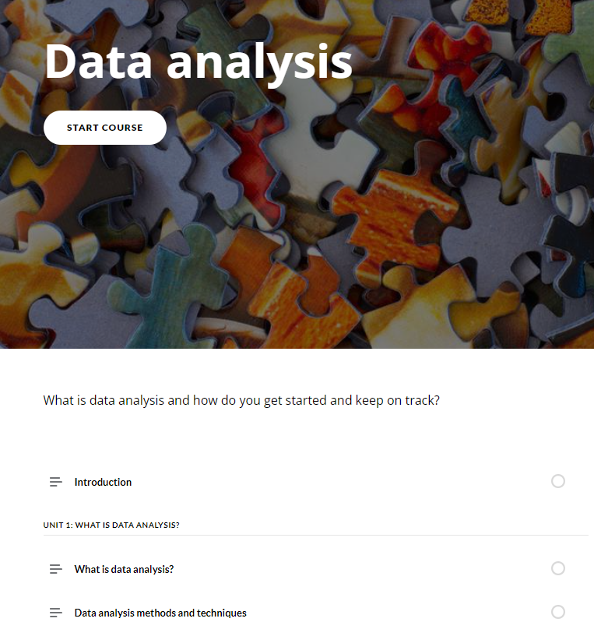
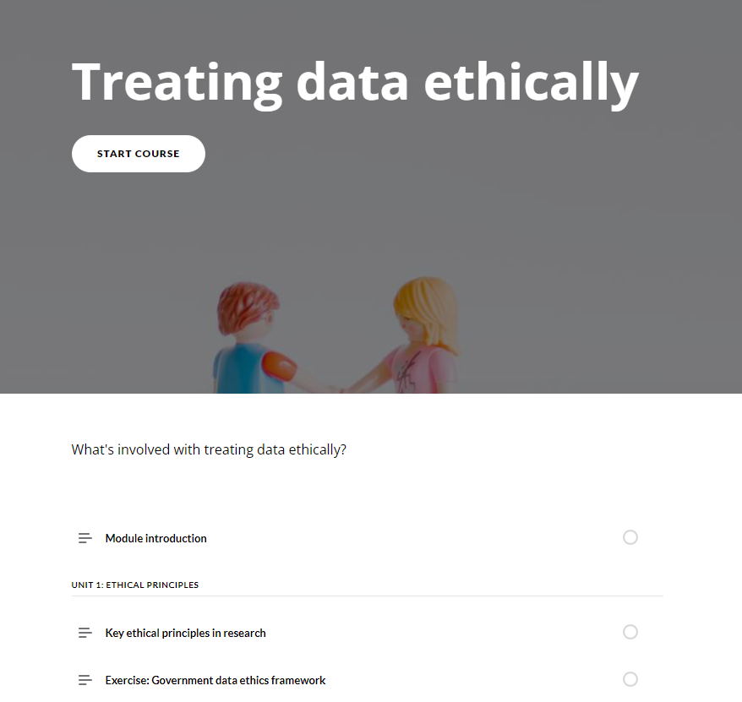
Doctoral Training Partnership (DTP) project
Drawing on the results of Data-driven research skills – UKRI
Collaboration with three ESRC Doctoral Training Partnerships (DTPs) to develop and implement an asynchronous training course
Introduction to finding and using data (4 modules)
DTPs providing funding and guidance
Initial pilot: designed and evaluated course.
Next phase: refine and embed into DTP training programs
Possible roll out to more DTPs

Slide 9
Qualitative research with students
AIM: To explore how UK Data Service online training events are supporting the development of quantitative data skills in SHAPE students.
Research conducted by Dr Vanessa Higgins & Professor Jackie Carter
Semi-structured online interviews (July-August 2022) with ten students, range of SHAPE disciplines, who attended UKDS online training events.
Interview topics:
Details of current and past studies?
Why attended event?
Learnt any new data skills from the event, and if so what?
Using those new skills in their current study/research?
Has training event had influenced their future plans?
Reflective thematic analysis (NVivo) using Braun & Clarke (2021) six-phase approach

Slide 10
Results – five themes
1. Gaining confidence to get started with quantitative data
2. Planning and designing research & assessing data sources
3. Applied, practical data skills
4. Inspiring further learning, career opportunities & cascading knowledge
5. Providing access to a research community, networking & peer-support
Recommendations for UKDS: (1) creation of communities of practice; (2) develop more asynchronous materials; (3) develop a data skills framework for social science students.
Journal article under review: Vanessa Higgins & Jackie Carter: Thinking Creatively About the Data Skills Gap.

Slide 11
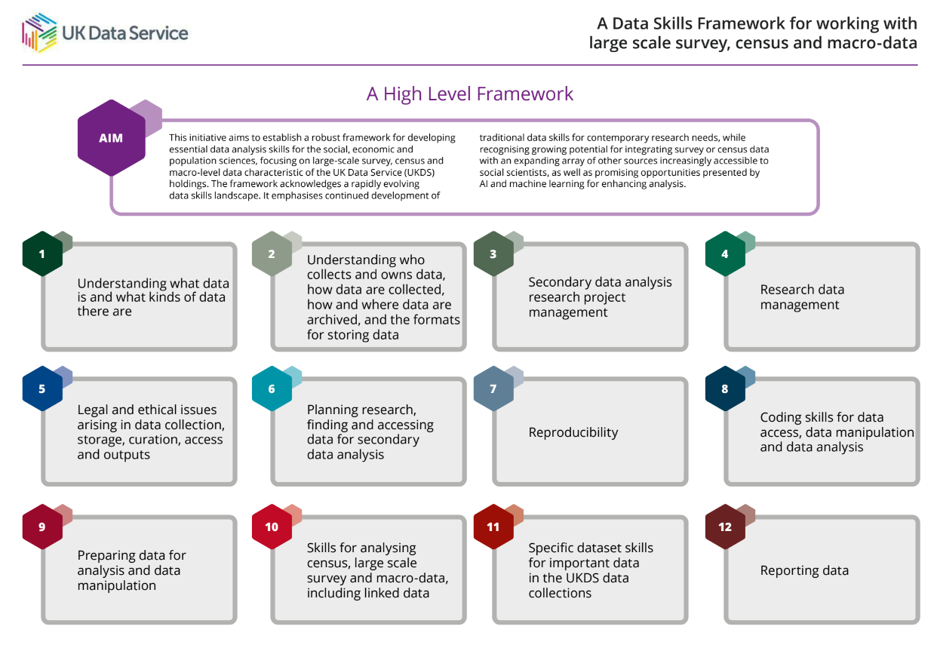
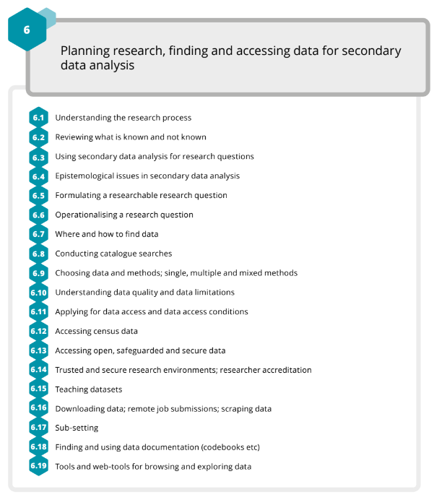
Data Skills Framework publication
Framework for building the skills needed now and into the foreseeable future for data driven analysis of social and economic issues
Skills for the quants data that we hold
Considers rapid advancement of technology and data
Consulted literature and in-house experts
Very positive feedback so far
https://zenodo.org/records/11110082​

Slide 12




Stay connected:
www.ukdataservice.ac.uk
@UKDataService
Subscribe to our newsletter
@UKDATASERVICE
Upcoming events: https://ukdataservice.ac.uk/training-events/
Online learning resources: https://ukdataservice.ac.uk/learning-hub/
@VanessaAHiggins
vanessa.higgins@manchester.ac.uk
Thank you for listening!

Slide 13
Events feedback 2022-2023
98% Agreed that the content was interesting
98% Agreed that the content was useful for their work/studies
97% Would recommend the event to others
99% Training provided them with increased knowledge on how to use Secure Lab
99% Training provided them with increased knowledge about Statistical Disclosure Control

Slide 14































Collaborations
UK social science data skills training landscape: network meets every 3 months for signposting and collaboration
Examples of other collaborations:

